Slide 1



DEVELOPMENT OF A PLATFORM (MOOC) FOR THE AUDIOVISUAL DIVISION
Internship Presentation
3rd Year in Computer and
Network Engineering
Prepared by:
Ayoub Majjid
Supervised by :
School Supervisor: Mr EL BOUNY
Internship Supervisor: Mr Mohammed Benabdelkrim
Notes:
Hello everyone, welcome to the demonstration of the CNIPE MOOC platform, developed to centralize online learning for the audiovisual division of the National Center for Pedagogical Innovation and Experimentation (CNIPE).
Before starting, I want to outline the plan for the presentation.

Slide 2
Presentation PLAN

Slide 3





Presentation Plan
introduction
design
Environment
Application demonstration
Conclusion
Notes:
Firstly, we’re going to begin with a brief introduction that will provide a simple idea about the project, including its objectives and context.
Next, we'll discuss the design section, which is a very important part and represents the starting point of any project. In this part, we will talk about the conception and the various UML diagrams.
Then, we’ll move to the third section, which covers the environment. In this section, we will discuss the technologies and tools we have used to create the project, including front-end and back-end development.
The fourth part will be the application demonstration, where we will show you a sample video that demonstrates our application and the various pages.
Finally, the last section will include a brief conclusion about the project and the experiences we gained from it.

Slide 4
Context

Slide 5
Context
This project details my internship experience within the audiovisual division of the National Center for Pedagogical Innovation and Experimentation (CNIPE) in Morocco.
My three-month internship was a valuable opportunity to create a MOOC platform. As a first-year IIR (Computer Engineering and Networks) student at EMSI and the lead developer, I designed a platform similar to Udemy to allow students easy access to the MOOCs offered by CNIPE.

Slide 6
Problematic

Slide 7
Problematic
As part of this project, the central issue is the following:
How can we design a simple and secure online learning platform that allows users to access a variety of courses while facilitating management and interaction between the different stakeholders (administrators, teachers, learners)?
Additionally, it is also necessary to ensure a smooth user experience with efficient content management (videos, comments) and access rights for each user category: owner, administrator, and user.

Slide 8
Objective

Slide 9
Objective
1. Project Idea: The initial need was to create a centralized platform for CNIPE's MOOCs.
2. Design: I will explain the different design stages, the technological choices, and the tools used.
3. Development: I will detail the development stages over a three-month period.
4. Page Display: Finally, I will showcase the platform’s pages.

Slide 10



Design

Slide 11
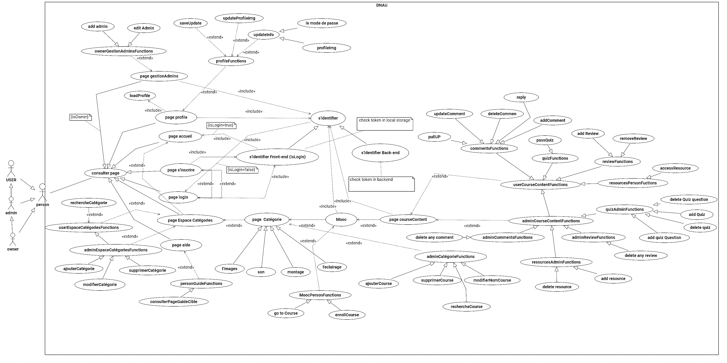
Solution
Notes:
In this diagram, we can see there are three types of stakeholders: the user, the admin, and the owner. The admin inherits from the user, and the owner inherits from the admin. So, what's the difference between these three types of stakeholders?
- User: The user can perform all basic activities like enrolling in courses, watching content, taking quizzes, adding comments, and posting reviews.
- Admin: The admin can do everything a user can, but with additional permissions. The admin can manage courses, categories, and content.
- Owner: The key distinction between the admin and the owner is that the owner has the authority to manage admins. The owner has access to a specific page that allows them to oversee and manage the platform’s administrators.
In summary, the user has limited functionality, the admin has managerial control over the platform's content, and the owner has control over the admins themselves.

Slide 12
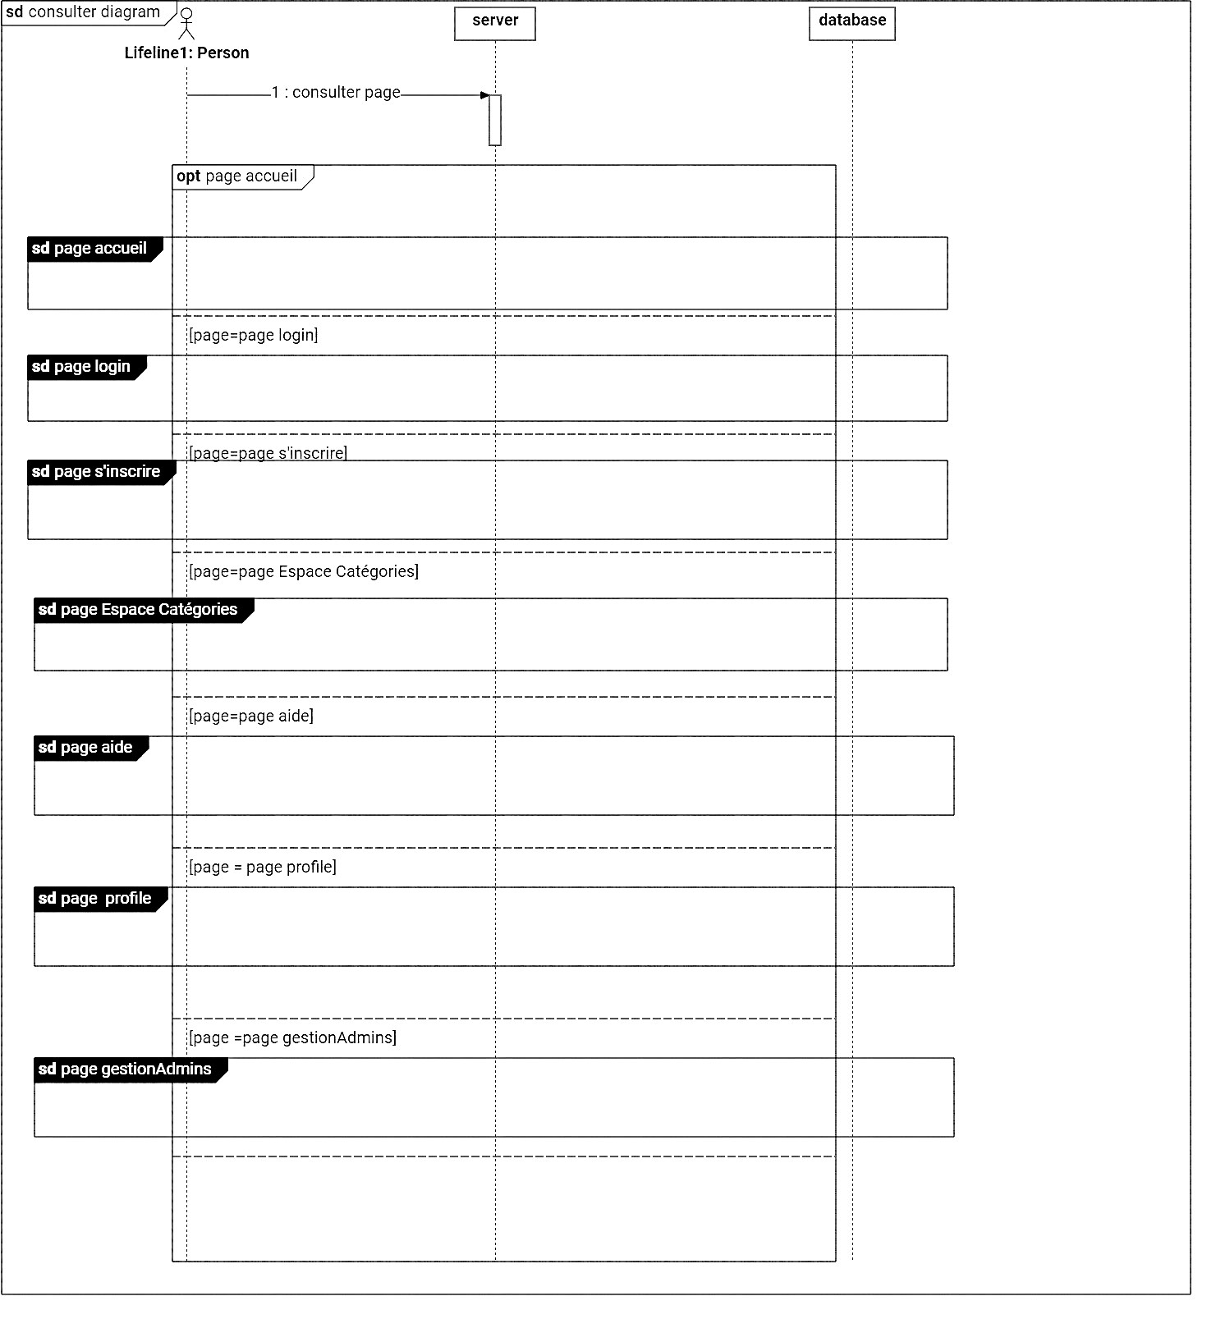
Solution
Figure : consult page Sequence diagram

Slide 13
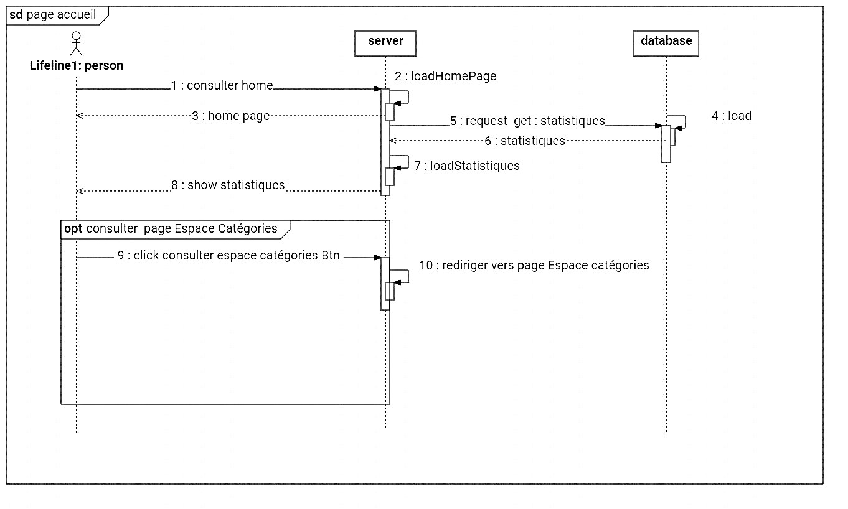
Solution
Figure : Home sequence diagram

Slide 14
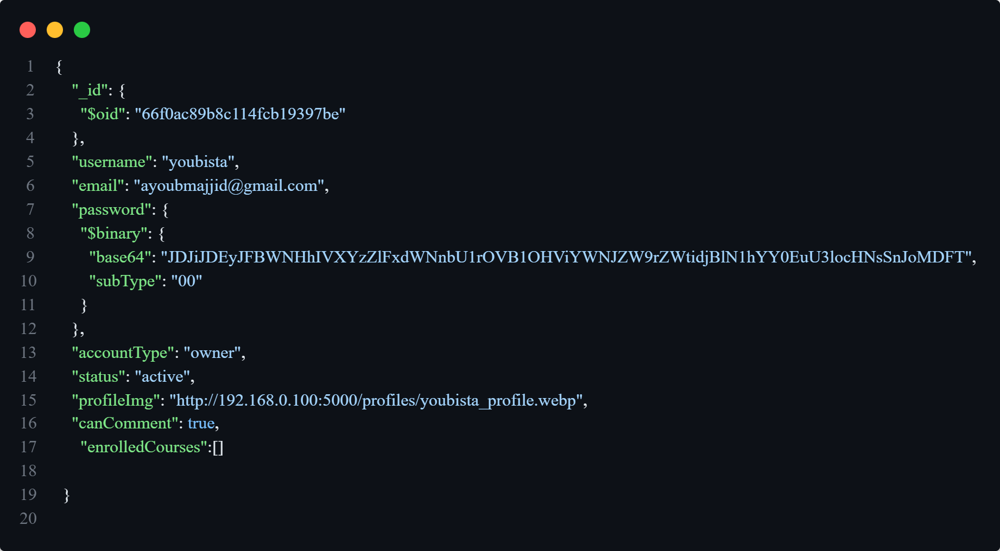
DB structure user

Slide 15
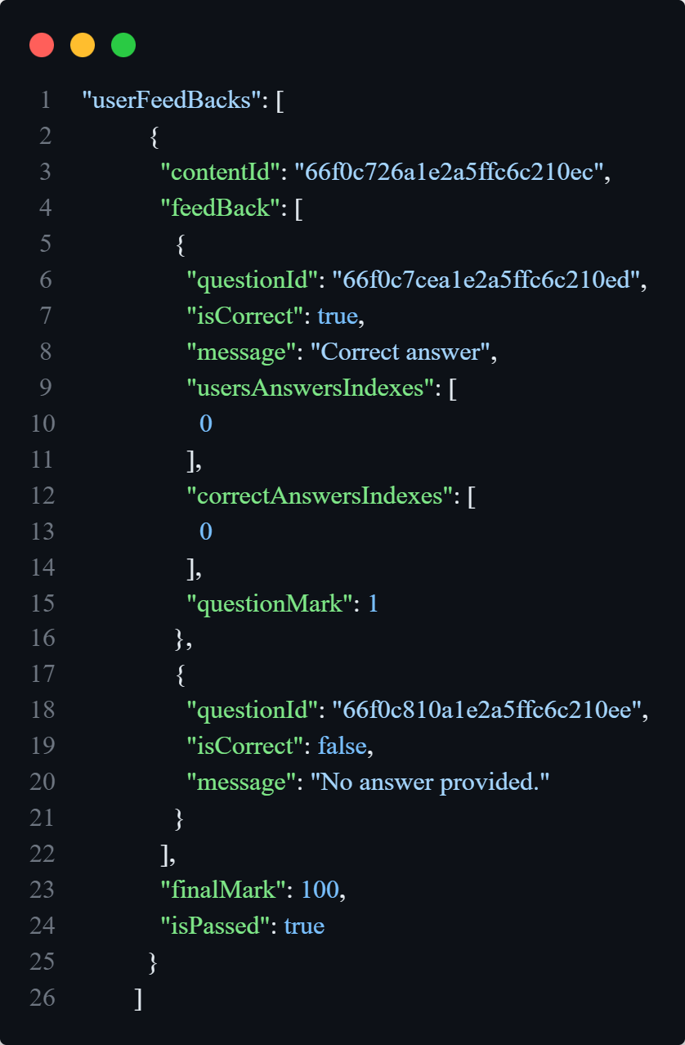
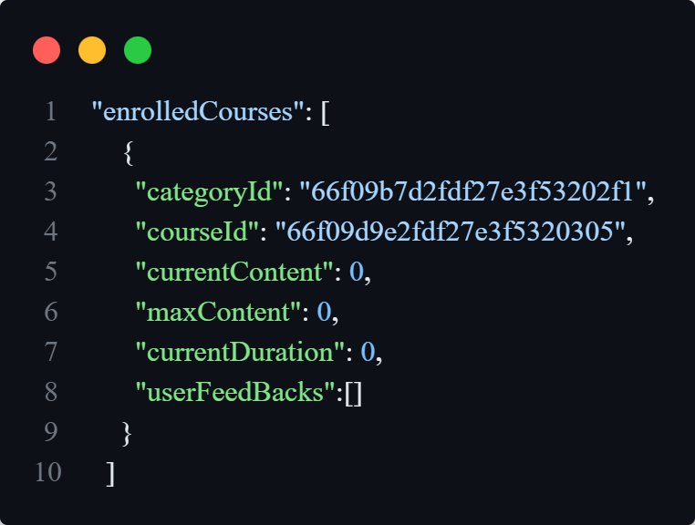
DB structure user/enrolledCourses

Slide 16
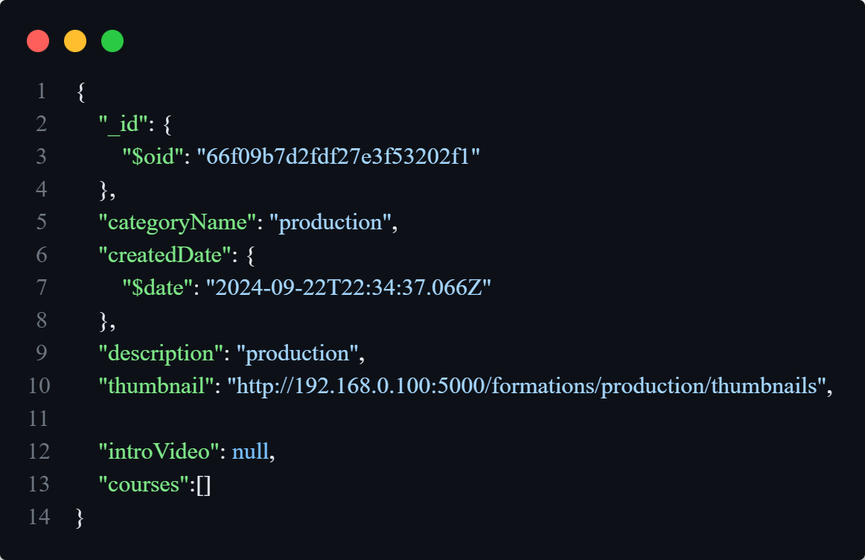
DB structure categories

Slide 17
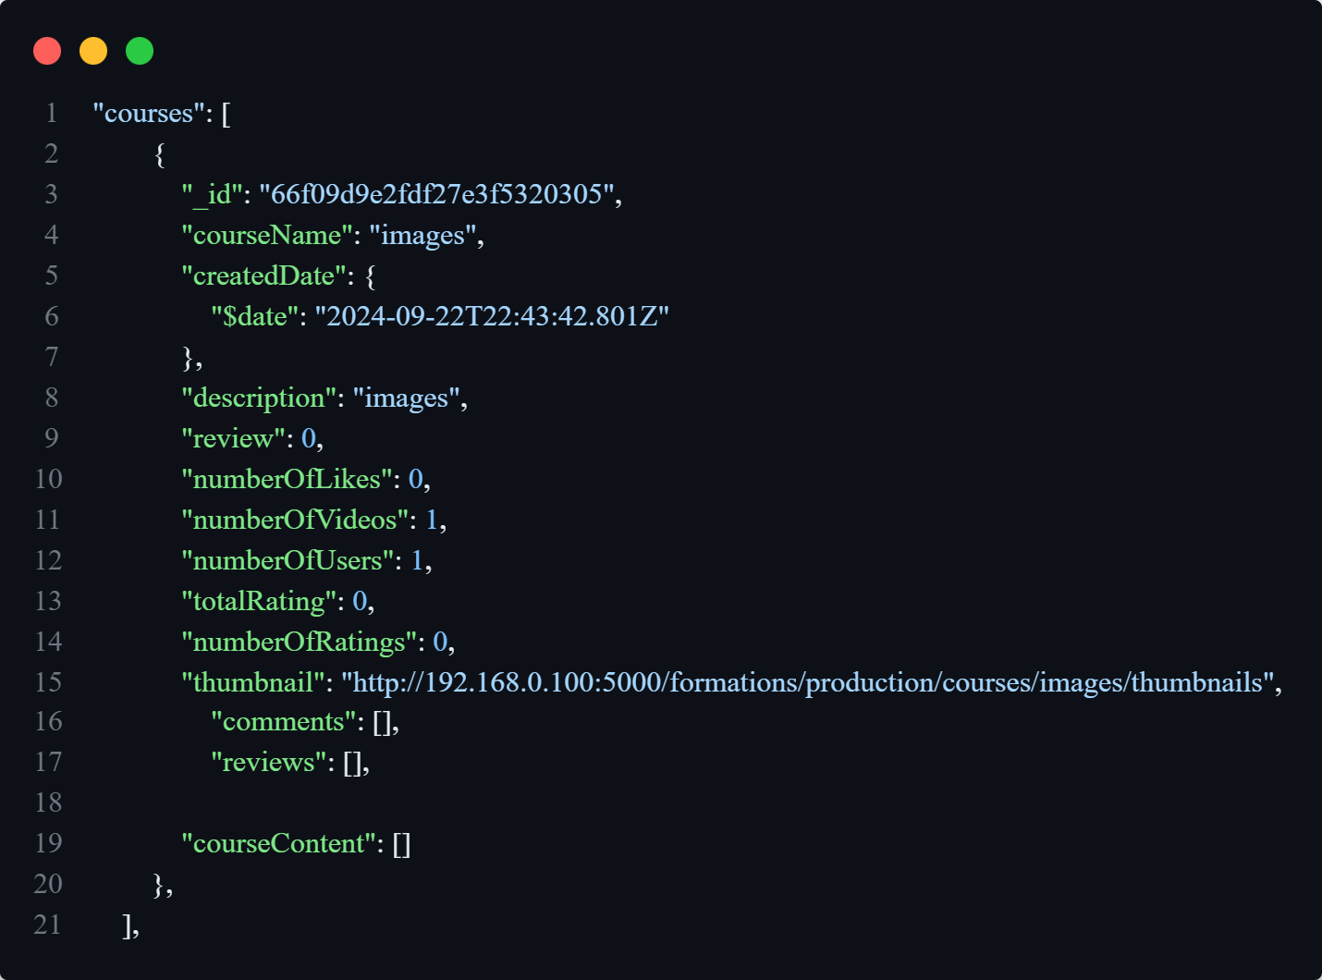
DB structure categories/courses

Slide 18
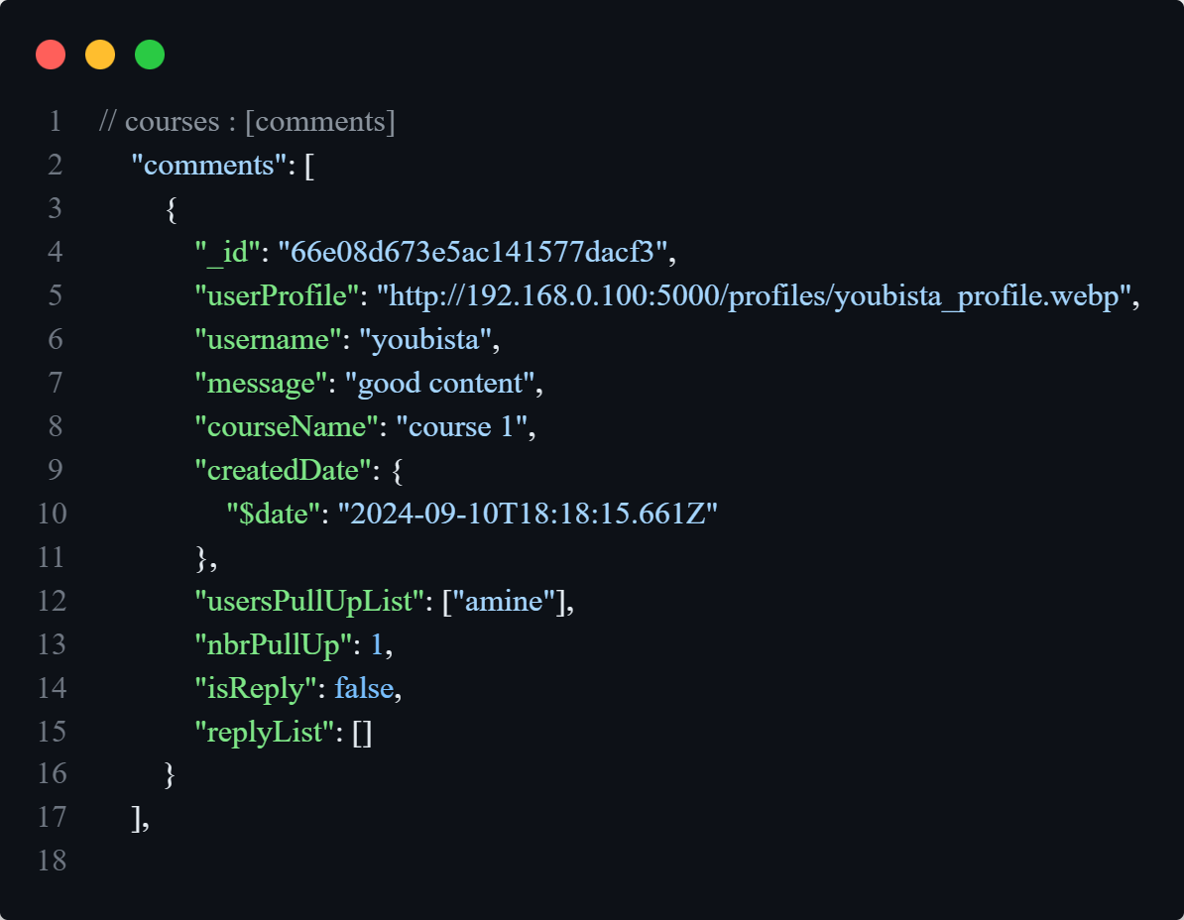
DB structure categories/courses/comments

Slide 19
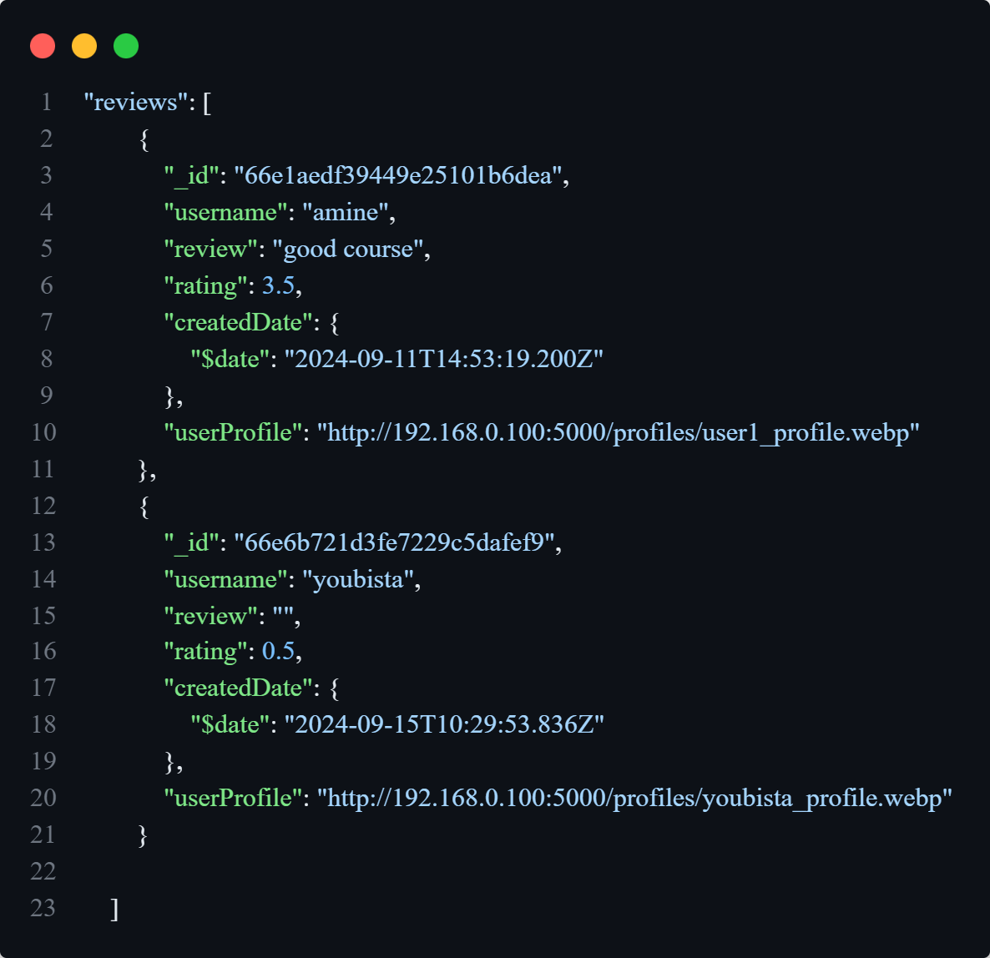
DB structure categories/courses/reviews

Slide 20
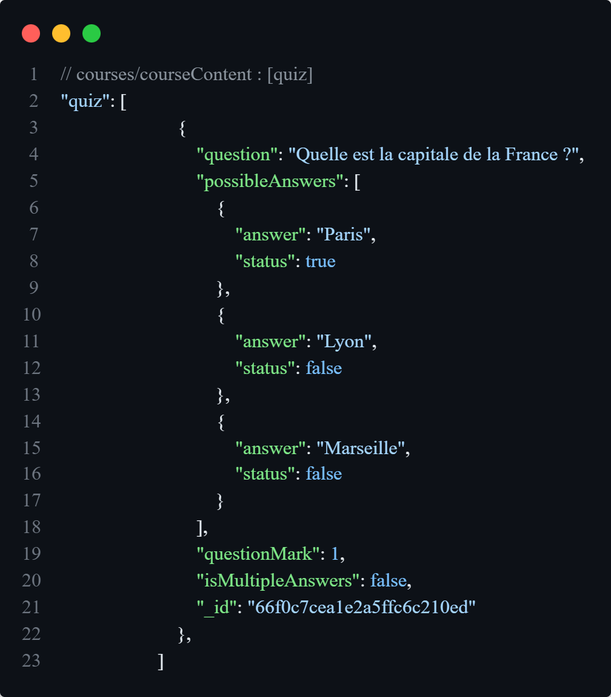
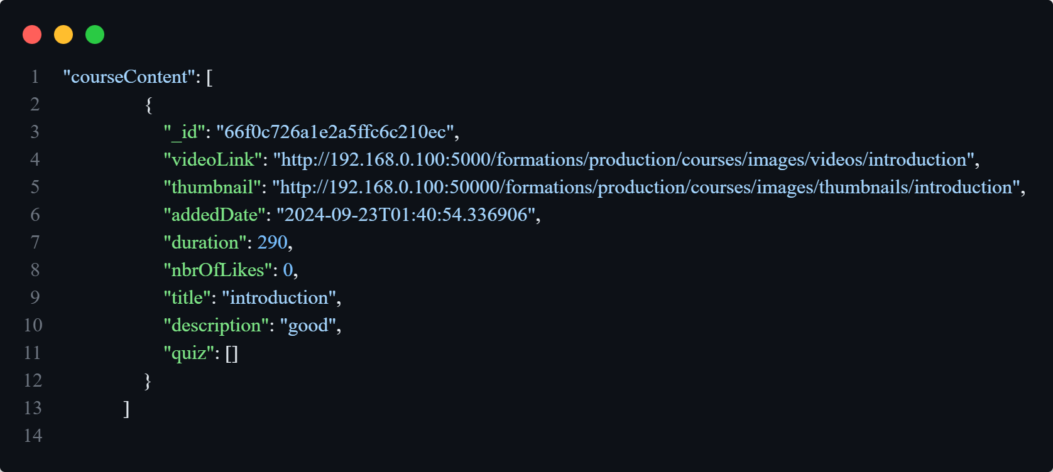
DB structure categories/courses/courseContent

Slide 21
Work Environment
Vs code
Startuml
Git/GitHub
VS Code is an Integrated Development Environment (IDE) known for its versatility and vast ecosystem of plugins.
PlantUML is a text-based diagramming tool used to create diagrams from textual descriptions.
GitHub is a collaborative development platform based on Git, widely used for hosting source code, version control, and collaboration among developers.

Slide 22



Work Environment (front)
html
css
javaScript
Markup language used to create the structure of web pages.
Style sheet language that designs the appearance of web pages.
Programming language that makes web pages interactive and dynamic.

Slide 23

Work Environment (front)
Figma
Collaborative design tool for creating UI mockups and prototypes.

Slide 24



Work Environment (back)
python
flask
MongoDB
Versatile programming language used for web development, data analysis, and artificial intelligence.
Python micro-framework for creating lightweight and flexible web applications.
NoSQL database that stores data as JSON documents for flexible data management.

Slide 25

Work Environment (back)
Postman
Tool for testing and developing APIs by facilitating the sending of HTTP requests and analyzing responses.

Slide 26
Application demonstration

Slide 27
Conclusion de Projet
Objective
Work Environment
The objective of the CNIPE project was to provide a centralized platform for students to access internship opportunities, job offers, and career guidance resources.
VS Code: Text editor
starUML: Design tool
GitHub: Repository platform
Steps
Conclusion
Analysis and research
Creation of a GitHub repository
Project design
Project implementation
Publication
This project resulted in a comprehensive digital platform that combines modern technologies and rigorous methodologies to meet the needs of users.

Slide 28
Thank you!
Ayoub Majjid

